Slide 1
Berserker
Presented by 8-bit Bacon

Slide 2
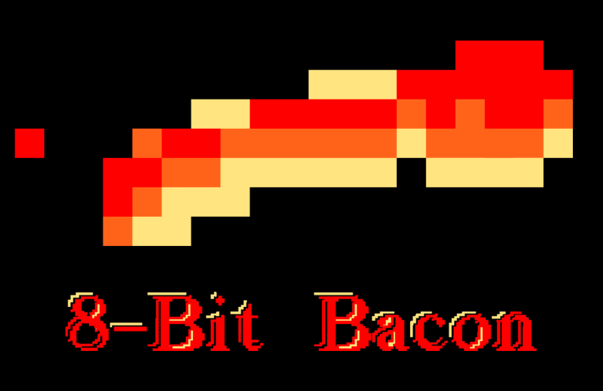









Our Team
Programmers
Artists
Anton
Lopez
Charles “CJ” Meade
Daniel
Lima
Justin
Maza
Matthew Birky
Roberto Rubiano
Sean
Welch
Oscar
Valera
Santiago Hoyos

Slide 3
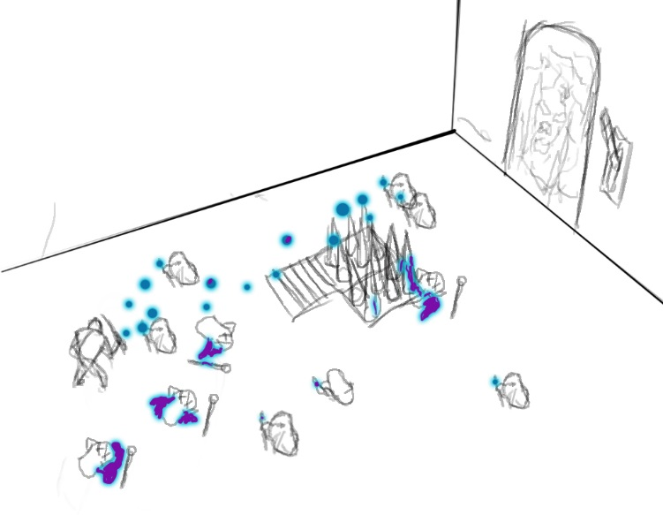
Game Vision
Berserker is a fast-paced, ¾ view intense hack-and-slash game.

Slide 4
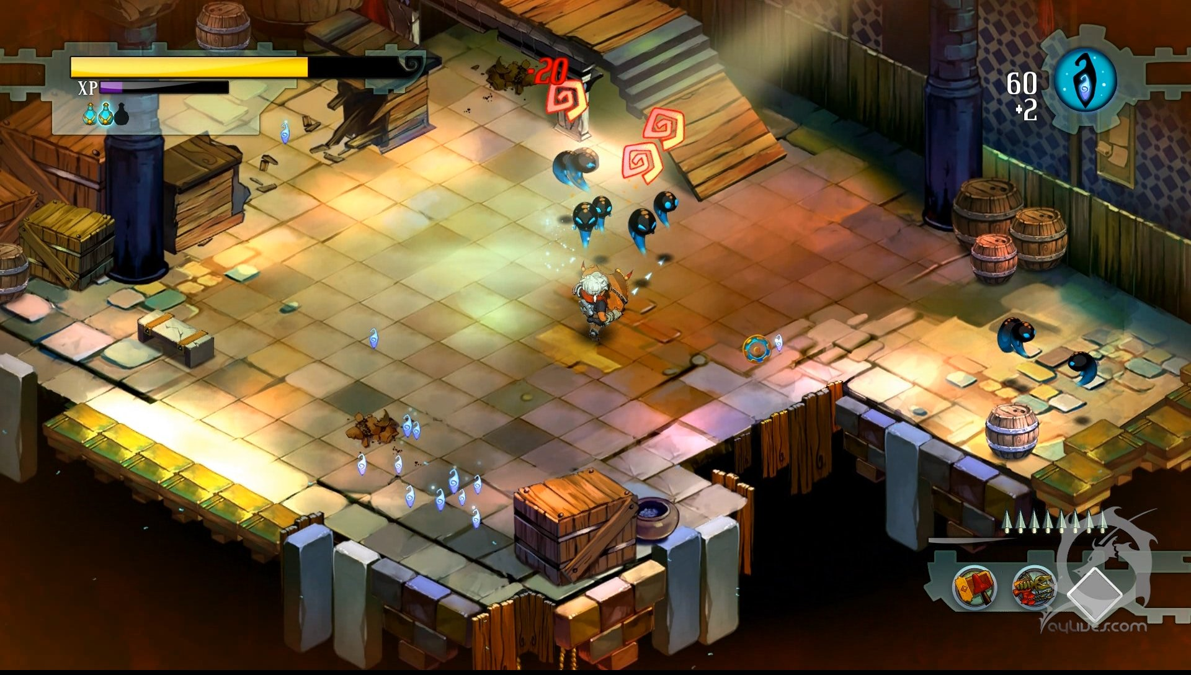
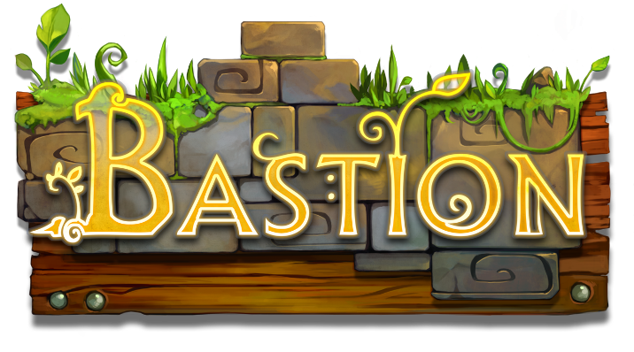
Inspiration

Slide 5
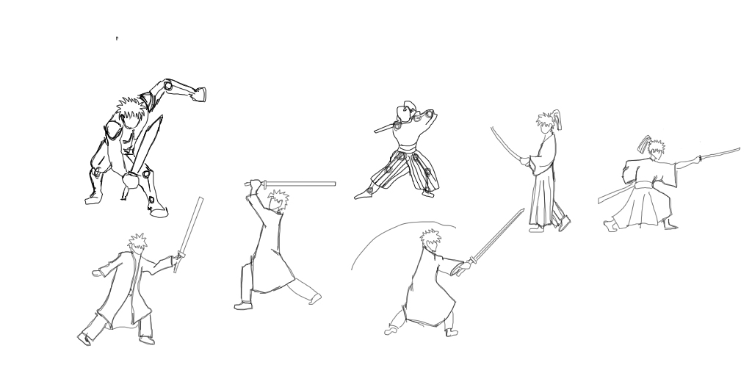
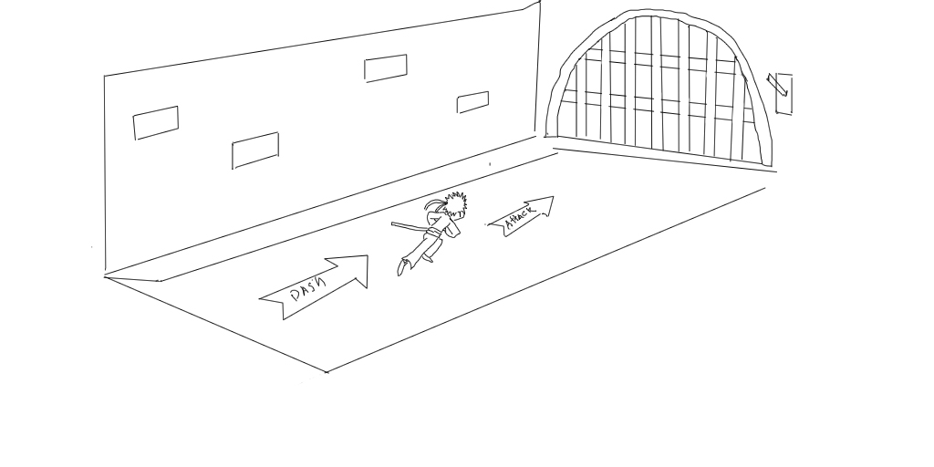
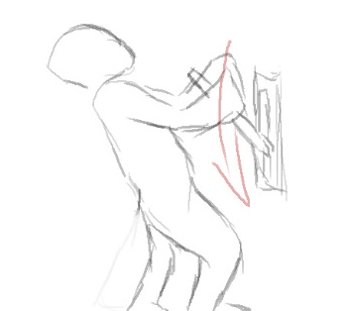
Player Actions
Attack
65%
Dash
25%
Grab
10%

Slide 6
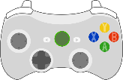

X Button
Attack
Mouse Left Click
Player attacks with their melee weapon.
Placeholder for Art
Placeholder for Art
Placeholder for Art
Damage enemies
Deflect projectiles
Manipulate the environment

Slide 7
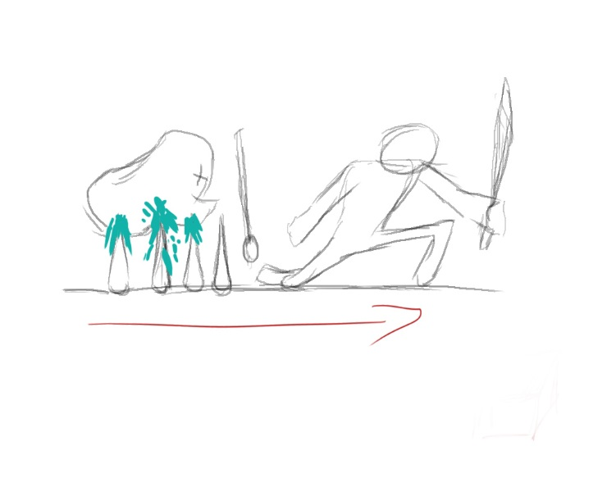
A Button
Dash
Space Bar
Player dashes in the direction they’re facing.
Placeholder for Art
Placeholder for Art
Evade enemies
Push enemies back
Avoid traps

Slide 8

B Button
Grab
Mouse Right Click
Player grabs an enemy or object in front of them.
Placeholder for Art
Grab and toss enemies
Flip levers

Slide 9
Game Flow
Progress
Combat
Progress
Combat
Exit

Slide 10
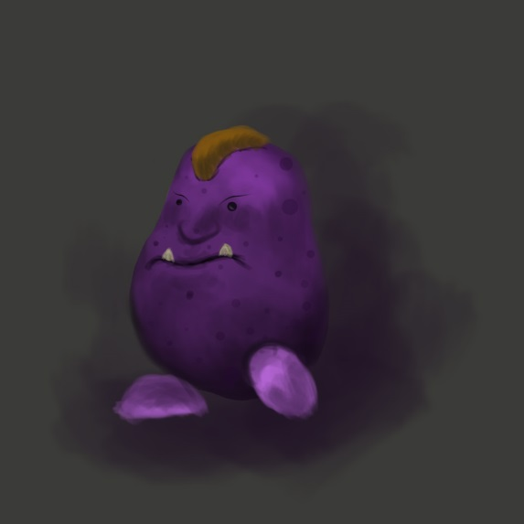
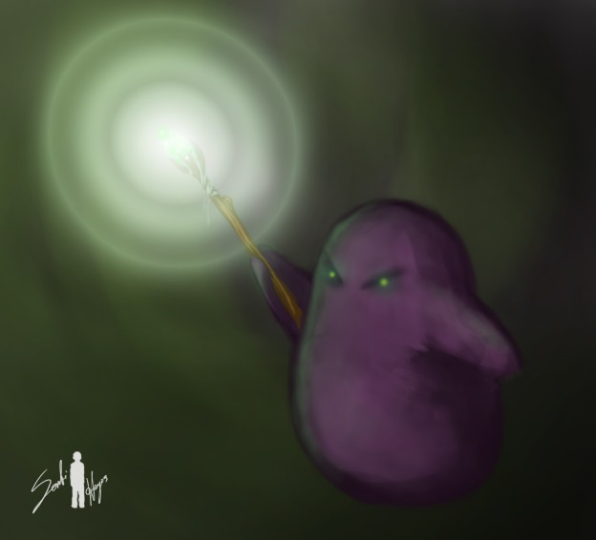
Basic Enemies
Melee “Blob”
Ranged “Blob”
If player is within view range (10m)
If player is within view range (30m)
Move towards player
Move towards player
If player is within attack range (1m)
If player is within attack range (10m)
Attack player
Attack player (1s)

Slide 11
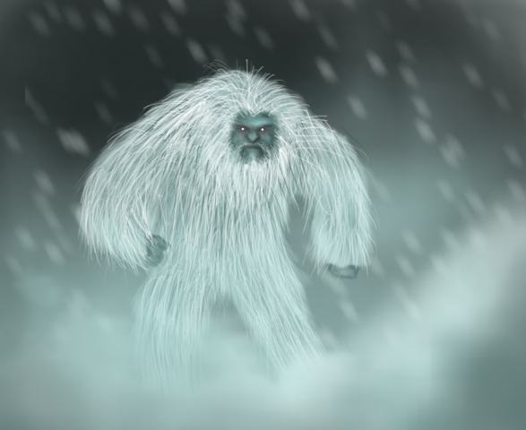
Special Enemies
Placeholder for Art
Placeholder for Art
Explosive Minion
If player is within view range (10m)
Move towards player
Yeti
If player is within view range (5m)
Move towards player
If player is within attack range (1m)
Activate bomb
Explode (2s)
If player is within attack range (2m)
Attack player (3s)
Magma Beast
If player is within view range (5m)
Move towards player
If player is within attack range (2m)
Attack player (3s)

Slide 12
The Hero
Placeholder for Art
The Hero is a seasoned, tall, lean warrior who wields a one-handed sword.
Attributes
Health
Lives
If Health = 0
If Lives = 0
Restart at checkpoint
Decrement lives
Game Over

Slide 13
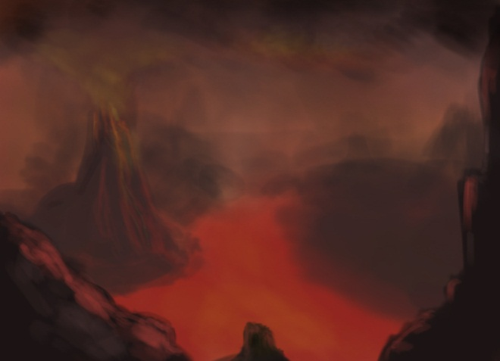
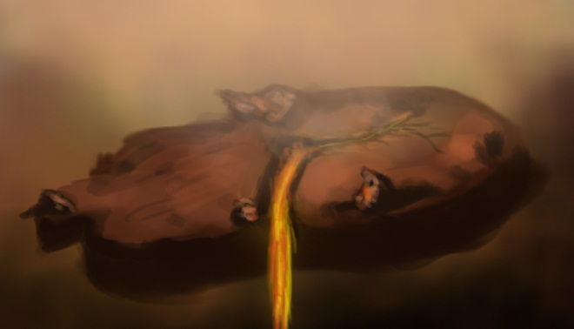
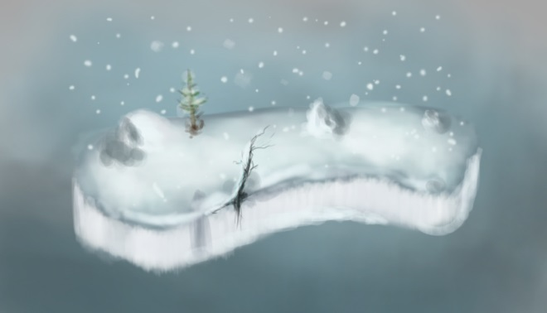
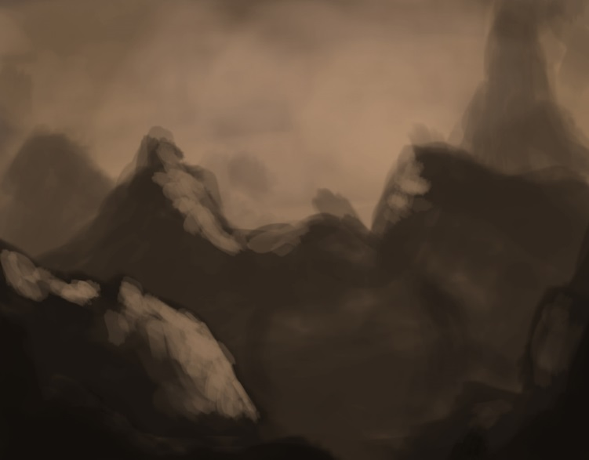
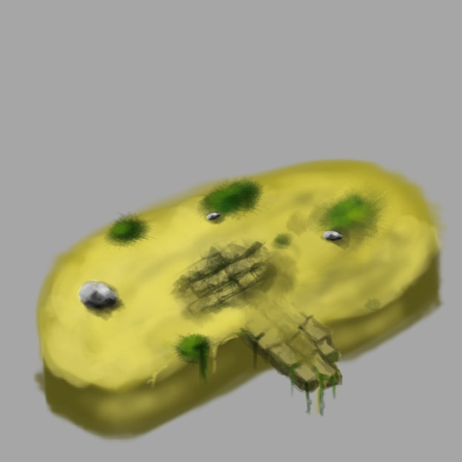
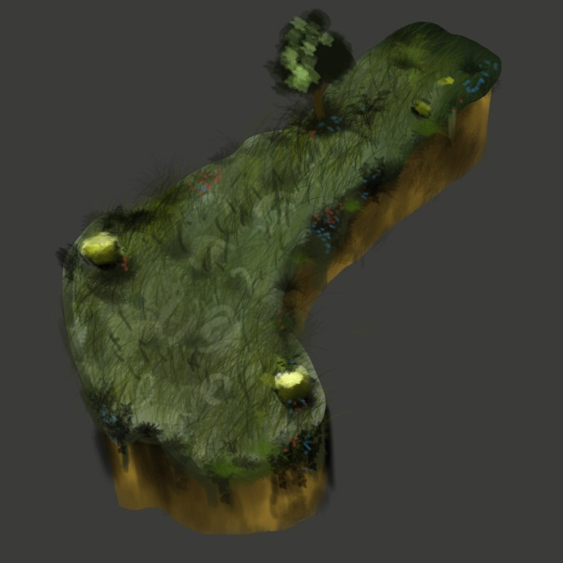
Where
Alternate fantasy realm

Slide 14
The Ice Realm
Where
An icy tundra consisting of…

Slide 15

The Lava Realm
Where
An evil realm, consisting of…

Slide 16
Where
The Wizard’s Castle
The place where the player confronts the evil wizard.
Placeholder for Art

Slide 17
Level Layout

Slide 18
Why
The player is on a quest to reclaim his lost love and defeat the evil wizard.

Slide 19
Wizard AI
Orb Attack
The wizard launches a fast-travelling orb at the player, which deals a small amount of damage if not deflected.
Tell: The wizard raises his staff over his head, then swings it downward at the player.
Orb Attack
Raise/ Lower Staff
Launch Orb
Small Damage
1.5s
0.5s

Slide 20
Wizard AI
Orb Attack (Concept)
Placeholder for Art

Slide 21
Wizard AI
Lava Plume
The wizard raises both arms above his head and creates a red space underneath the player, which erupts after a small period of time.
Tell: The wizard raises both arms over his head, and his hands glow red.
Lava Plume
Raises arms
Creates plume
Large Damage
1.0s
2.0s

Slide 22
Wizard AI
Lava Plume (Concept)
Placeholder for Art

Slide 23
Wizard AI
Summon Minions
The wizard can call minions to his aid to assist him in the fight. This attack does no damage.
Tell: The wizard slams his staff to the ground, opening a gate that spawns minions.
Summon Minions
Slams staff
Opens gate
No Damage
0.5s
0.5s

Slide 24
Wizard AI
Summon Minions (Concept)
Placeholder for Art

Slide 25
Wizard AI
Fight Stages
Boss state changes based on health. When the boss’ health hits zero, the boss is defeated.
Fight Starts
Orb Attack
Lava Plume
Summon (15s)
Boss Dies
66% HP
33% HP
Orb Attack
Lava Plume
Orb Attack

Slide 26
HUD
Placeholder for Art

Slide 27
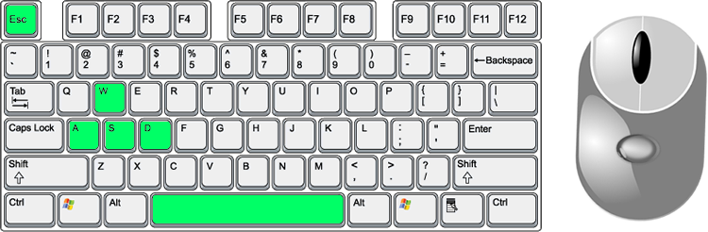
Controls
Pause
Attack
Grab
Move
Dash

Slide 28
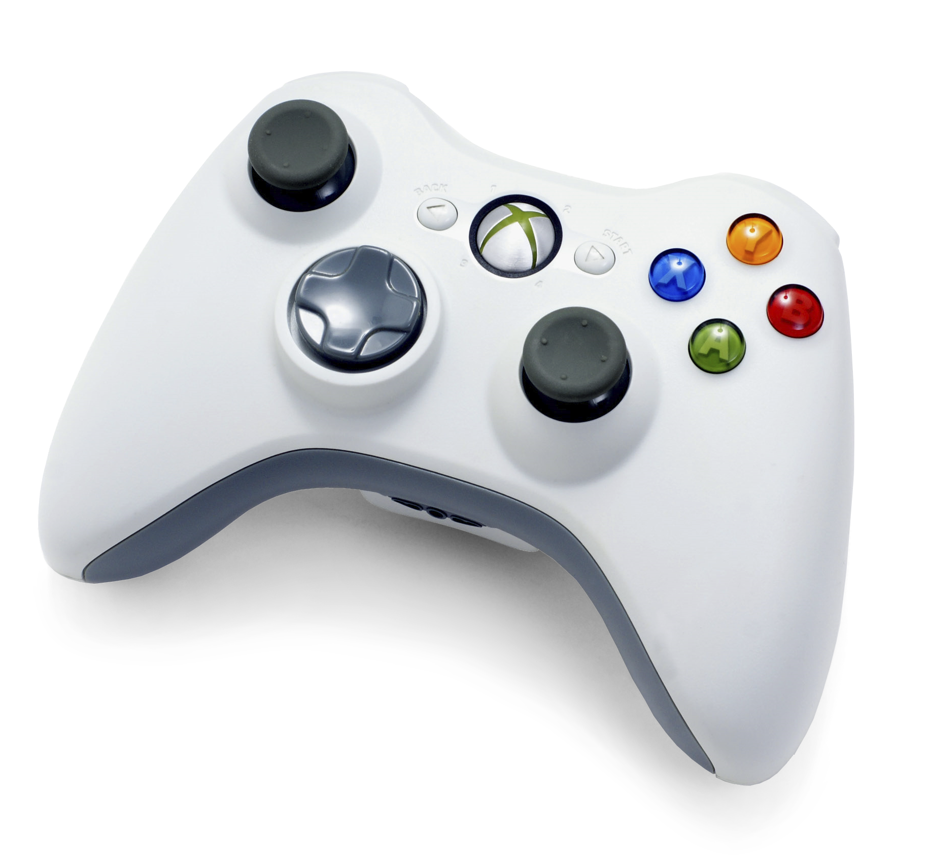
Controls
Attack
Move
Grab
Pause
Dash

Slide 29
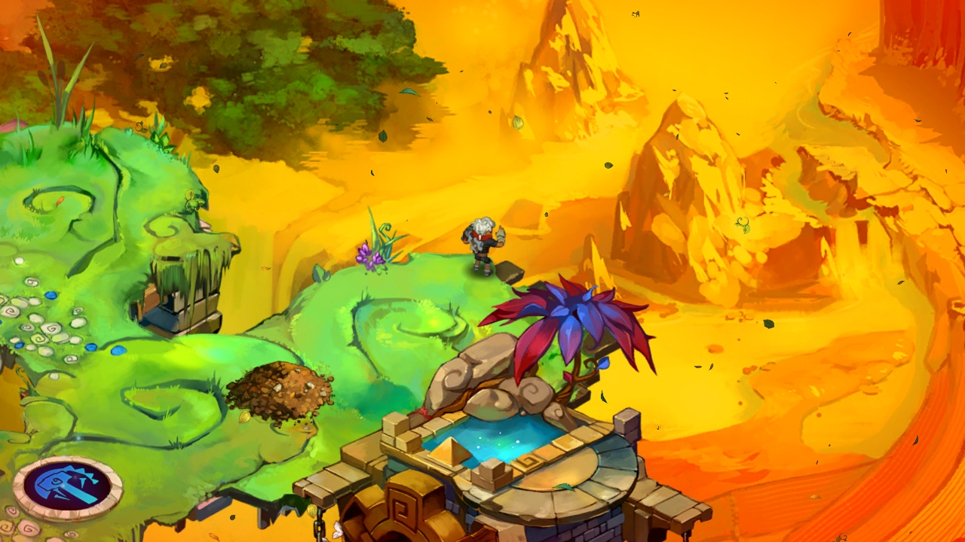
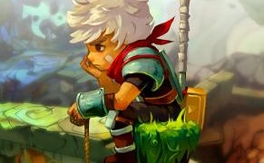
Art Style

Slide 30
Recap
Intense, fast-paced ¾ view Hack-and-Slash
The mechanics are based on attacking, dashing and grabbing/throwing things
Takes place in an alternate fantasy realm
You control a seasoned warrior who is on a quest to save his lost love.

Slide 31
Questions?

